Slide 1
Visualizing Data
Part Two: Design and Tools
Notes:
In Part Two of this presentation, we’re going to focus on good design tips for data visualization, as well as go over some suggested tools and workflow. The majority of these design principles are valid for designing PowerPoint slides as well as data visualizations; or for formatting graphs and figures that you might choose to include in a PowerPoint presentation or policy brief.

Slide 2
DESIGN
Notes:
Let’s begin with some concrete ways to make your data visualizations better through design.

Slide 3
Use Your “Ink” Strategically
Every single line, word, and shape should aid in the understanding of the graphic
If not, delete
Add elements when helpful
Notes:
The first rule is to really think about all the design elements that appear in your graphic—each line, word, or shape. One well-known principle in data viz design is the idea of the “data-ink ratio,” meaning you should try to communicate the essential data with the minimum amount of design elements on screen. Ask yourself, is each element necessary? If it’s not doing anything to help the understanding of the graphic, then delete it. But if you think something is unclear and would be aided by another line or word, go ahead and add it.

Slide 4
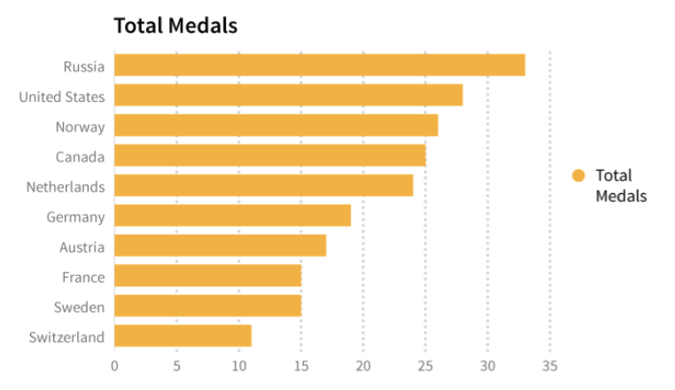
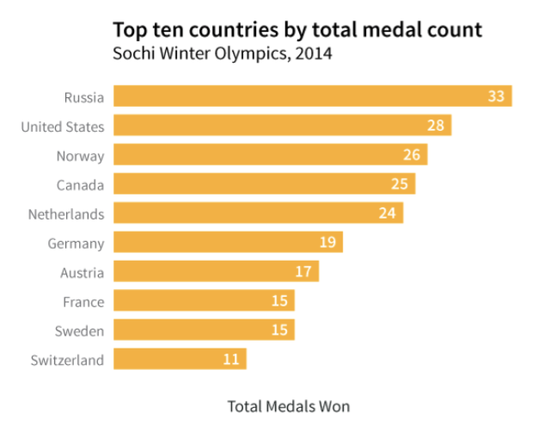
Use Your “Ink” Strategically
Data + Design
Notes:
On the left, we have a typical bar graph where we have an x-axis with labels and a legend. The title and the legend both read, “total medals.” The vertical lines help you line up the bars to the correct number beneath. But is all of this necessary? Also, the title is not very helpful. Medals for what?
[Click] Now we see an improved version of this graph. The title was edited to be more specific. It reads, “top ten countries by total medal count, Sochi Winter Olympics, 2014.” We removed the x-axis numbers and put them directly in the bars themselves so no need for vertical lines either. We’ve still labeled the x-axis to make it very clear that those numbers in the bars are for medals. Visually, the example on the right is cleaner. Less work to determine the numbers for each country.

Slide 5
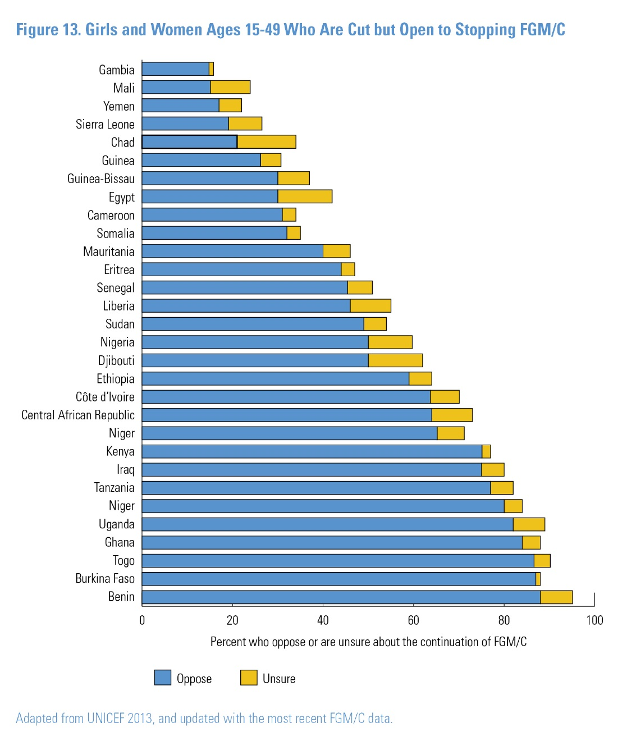

Use Your “Ink” Strategically
© 2016 Population Reference Bureau
Notes:
Here’s another before and after where we’ve removed some elements because they weren’t helping and also added something in. These graphs show girls and women ages 15-49 who have undergone FGM/C, but are open to stopping the practice. The black lines that bordered each bar were removed. The gray vertical lines were added in this case. Unlike the previous slide, we didn’t want to label each bar because there were so many countries and it would have cluttered the screen. Plus we are more interested in here in a general sense of which countries have lower or higher rates of opposition to the practice versus knowing what the exact percent is.
This is a lot of countries to include on a PPT slide – it’s probably hard for you to read the country names and see the ones you’re interested in. So if this is a data viz that will be a PowerPoint slide, you would probably want to reduce countries, or find a way, such as through color, to draw the audience’s attention to the one or two countries you are highlighting.

Slide 6
Text Tips
Use sans serif fonts (Helvetica, Arial, Gill Sans are good options)
Ways to create emphasis: ALL CAPS, bold, italics, bigger
Keep fonts consistent
Can use title text for takeaway message
Notes:
Now, for some standard rules on text. We want to use sans serif fonts. These are the ones that don’t have extra extensions on the ends of letters. This keeps text clean and simple and easier to read. Some easy ways to create emphasis are to use all caps, or make words bold, italicized, and/or bigger. But don’t go overboard with these options - think about which words really need the emphasis and try not to do too many for one graphic or slide. Keep fonts consistent. When you see a presentation with different fonts, it starts to look very amateur. It’s also distracting. Also, don’t forget to utilize that title text. Sometimes you may want it to be very direct about what the data is showing. But depending on your audience, you may alter the title to make the central message clearer.

Slide 7
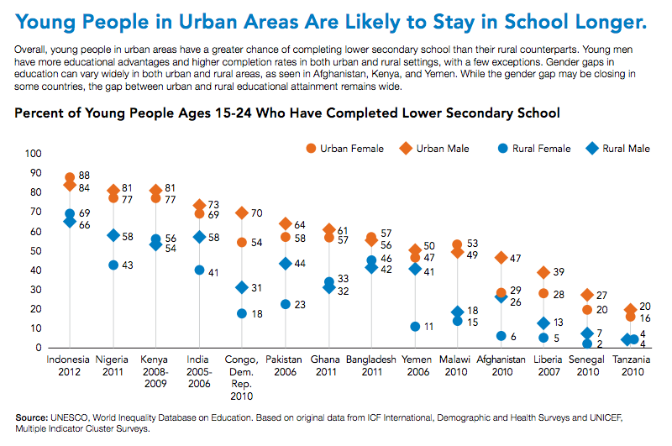
Put the Key Message Right in the Title
© 2015 Population Reference Bureau
Notes:
In this example, we have a two part title. There’s a topline title that is the takeaway message. It reads, “young people in urban areas are likely to stay in school longer.” Then right above the data viz is a more technical title that reads, “percent of young people ages 15 to 24 who have completed lower secondary school.” You might see something more like the topline title in a newspaper. The bottom one would be for more technical audiences. In this case, it was for a data sheet that could potentially be used by multiple audiences.

Slide 8
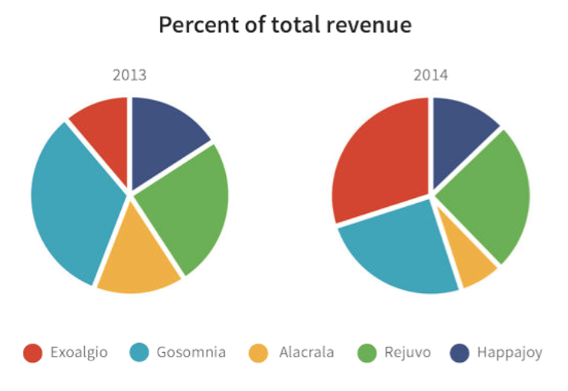
Text Instead of Graph?
Data + Design
Notes:
Here’s an example that we often come across. It’s before and after pie charts, where you’re supposed to see how each segment changed over time. However, with pie charts, it can be difficult to compare segment sizes. When you have changes over time among different categories, some better options could be bar charts or an area chart. Another option could be…

Slide 9
Text Instead of Graph?
Exoalgio’s revenue grew
110%
between 2013 and 2014.
Notes:
…to call out a data point using just text. You may want to do this if there’s really nothing else interesting going on in those graphs or this is all your audience cares about. Here, we’ve made the 110% text bigger and green to highlight the positive aspect.

Slide 10

The Importance of Color
Data + Design
Notes:
Now let’s talk about color. Most people don’t spend much time choosing the colors for their PowerPoint presentations. Color is something we often take for granted, but it is very important for data viz because it is a tool for communication. Looking at these two graphics, it is much easier to see the boundary between the blue and red sides of this square on the left than it is between the circles and squares on the right. Our brains are designed to process color much more quickly than shapes or text.
Professional designers can spend hours thinking about which exact colors they want to use, making sure they harmonize well and reflect the “look” they want to achieve.

Slide 11
Color Tips
Darker/brighter colors will read as “more”
Use gray to denote neutral or unimportant data
Utilize white space
Every color used must have a reason for being there and should be distinct
Choose appropriate color palette and keep them consistent
Notes:
Here are some basic color tips for you. Darker or brighter colors will read as “more.” So you generally want higher numbers or quantities to be associated with stronger colors.
Gray is often overlooked as a color choice, but it’s very useful when you need to show something, but don’t want it to take as much attention.
Utilize white space. Make sure things aren’t crowded together. White space can help create some cushion between things so it doesn’t look messy.
Every color used must have a reason for being there and should be distinct. Similar to our “conserve your ink” approach, we want colors to also be used strategically. Choose an appropriate color palette and keep them consistent.
We also don’t want colors to be too distracting. Once you’ve figured out a color scheme, keep them the same across your presentation.

Slide 12
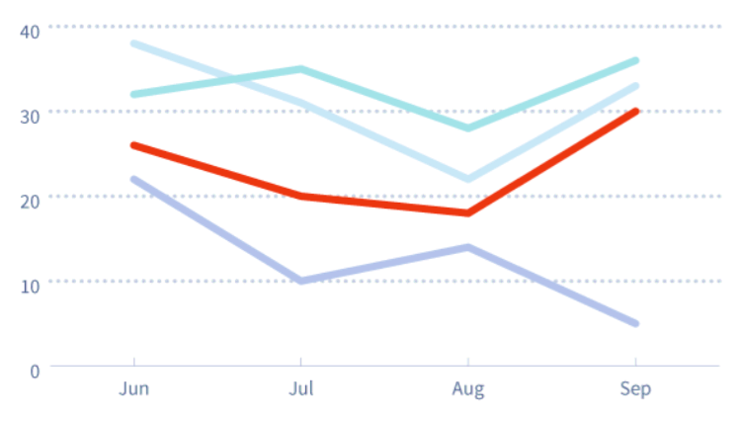
Color Has Meaning
The higher the contrast between objects, the more differently they are perceived
Colors also have symbolic meaning
Data + Design
Notes:
Keep in mind that color has meaning. The higher the contrast between objects, the more different they are perceived. In this example, you can see how the red really stands out among the other colors. This could be one way to draw attention to a specific data point. But also remember that because colors have meaning, you must be careful which colors are linked to certain categories. Red can be perceived as something negative.

Slide 13
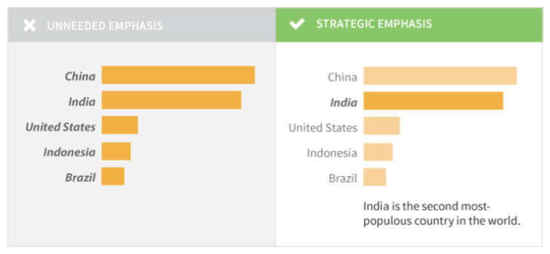
Color Ideas
Data + Design
Notes:
Here, you can see how a stronger color draws your eye to the row for India in the chart on the right. This, combined with the text changes (the italics and extra line at the bottom), makes it really clear what you are trying to emphasize.

Slide 14
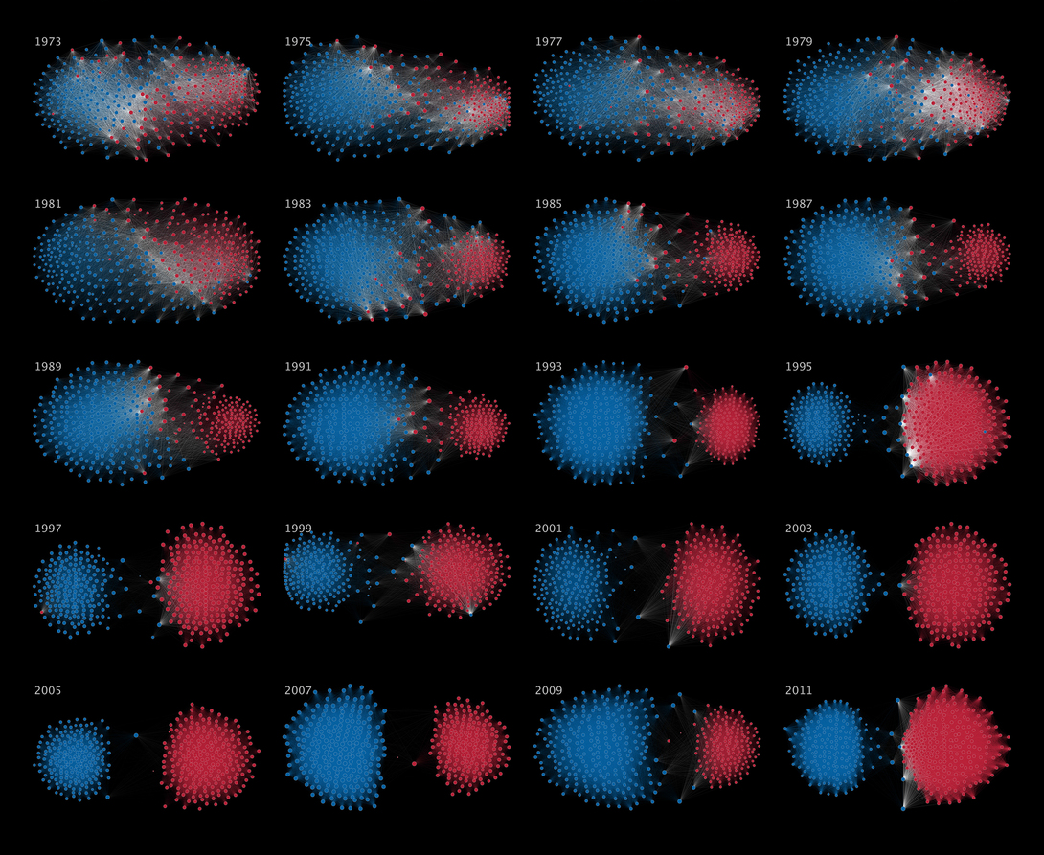
Votes Across Party Lines in the U.S. House of Representatives
© Mauro Martino
Notes:
This data viz relies on color to tell the story. This shows votes across party lines in the U.S. House of Representatives. In the 1970s shown in the top row, the two groups had more crossover in their voting patterns. You can see this because the blue and the red dots are more spread out and have some crossover.
In later years – shown especially in the bottom row - they have been steadily voting more and more within party lines, creating a separation between the two parties.

Slide 15
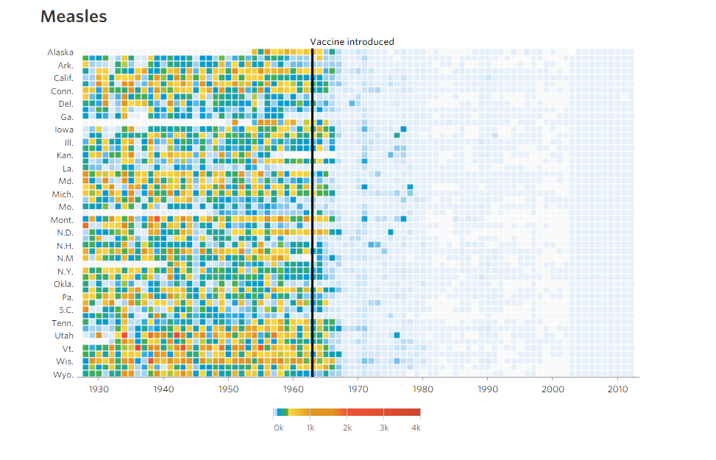
Effectiveness of the Measles Vaccine
© Dov Friedman, Tynan DeBold
Notes:
This is another example where color really makes the data viz. This shows the effectiveness of the measles vaccine. States are listed in each row and each column is a year in time. We have a range of numbers corresponding to shades from light blue to red representing the number of measles cases. Red is used to indicate the highest number of measles cases, which is around 4,000 in one year. The big black line going up the middle indicates the point when the measles vaccine was introduced. Notice how the colors quickly disappear across the states and turn into this light blue shade, which is close to zero cases.

Slide 16


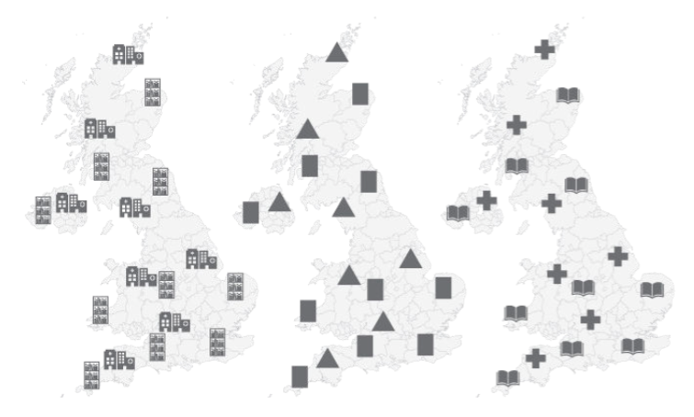
Icons
© 2016 Population Reference Bureau
Data + Design
Notes:
Icons are little symbolic images that can add some visual flair to an otherwise text heavy or number heavy graphic. You can use them to depict percentages, like these figures here in the top left. This would represent 1 in 10. Sometimes they are used when you may not necessarily have a data point to show, but you have a fact or bit of information that could use some visual cue on what it’s about. You find them a lot in infographics. At the bottom, we are showing how icons may or may not help in the design of a map. Can you tell which map is showing libraries and hospitals? So if you choose to use icons, make sure people can instantly tell what it is you are referring to.
A good resource for icons such as these is thenounproject.com.

Slide 17
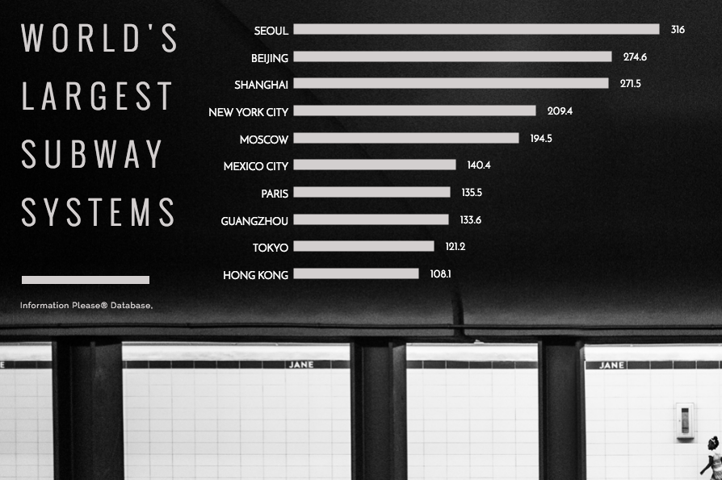
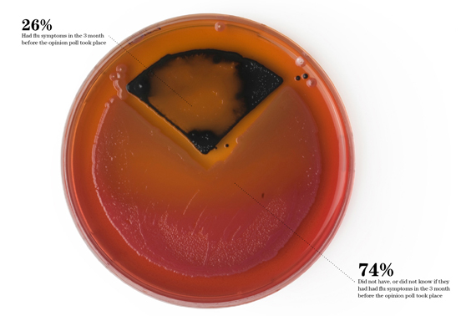
Photography
© Peter Orntoft
Notes:
This is perhaps an unusual way of presenting data visually, but it can be effective. You can lay a graph over a relevant photograph to add visual interest. In the right-hand example, it’s a chart about subway systems on top of a photo of a subway. Or in the bottom left example, sometimes a photo can be manipulated to be the actual data viz. This is a pie chart about healthcare made with a petri dish.
To use photos or this type of imagery in your data viz, you will probably need to rely on the specialized skills of a graphic designer.

Slide 18
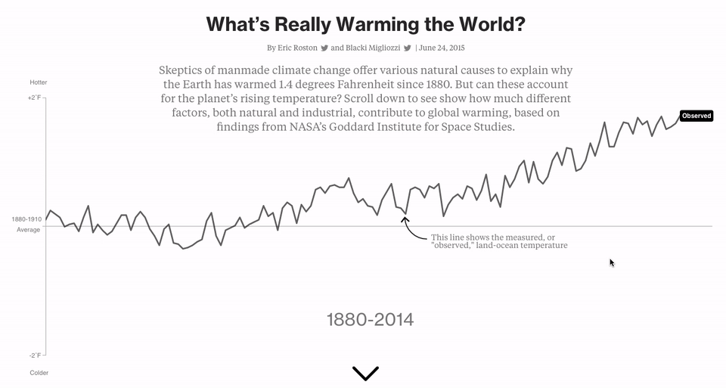
Interactivity
© Bloomberg
Notes:
For those of you who want to do something more advanced, perhaps for a website, consider the power of interactive data visualizations. When you add in motion and clicks by the user, you can open up entirely new ways of presenting data. To produce something like this example, you would need to reach out to a developer to code this for you. This is a multi-part data viz that shows the data associated with climate change. With the interactive element, the user can investigate each data point separately, creating a much richer and more educational experience.
There is a website called Infogram that can build simple interactive graphics. You copy and paste the code it gives you then embed it on your website, similar to how you would embed a YouTube video.

Slide 19
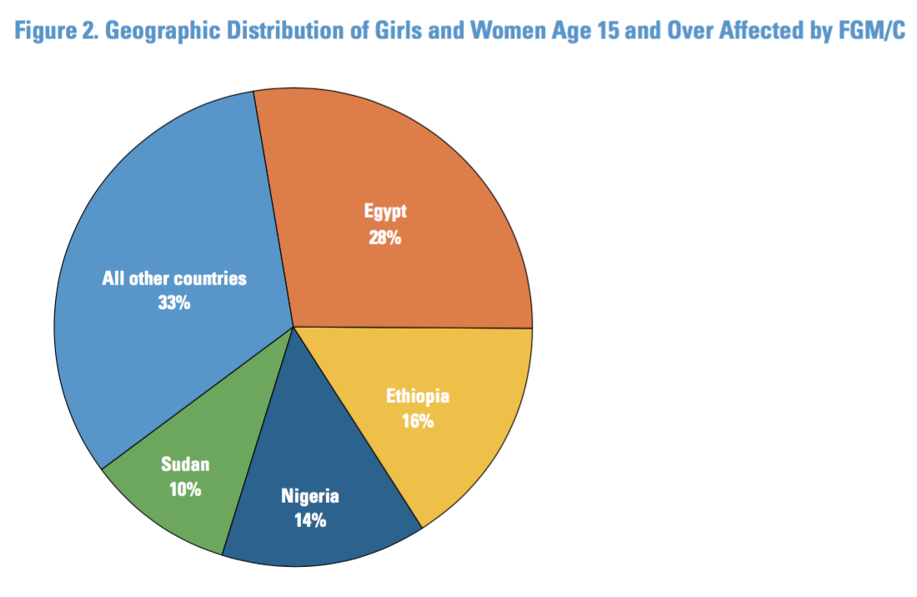
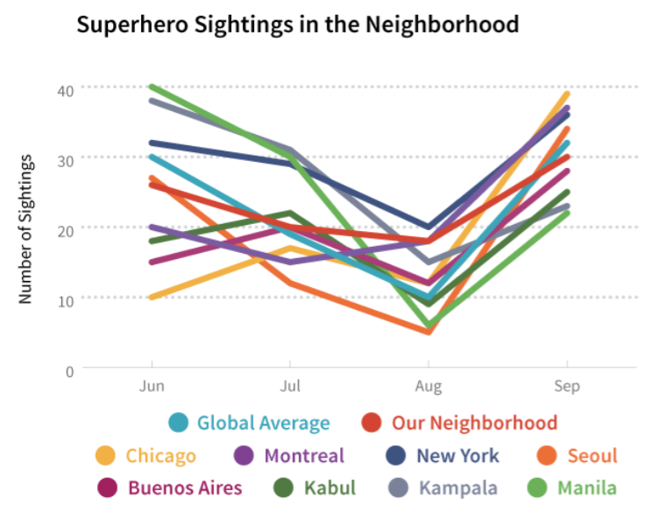
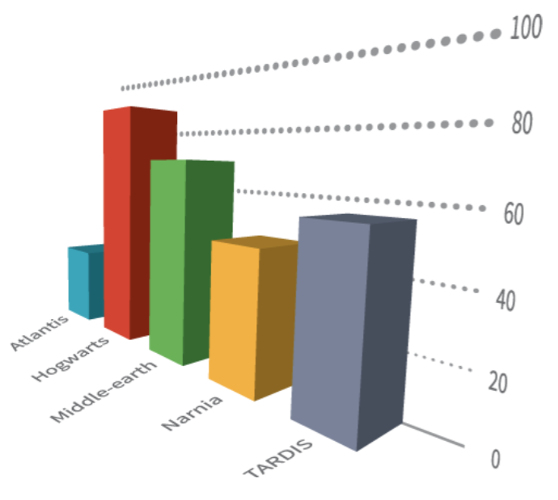
Assignment: Make it Better
Discuss how you would improve the design
© 2016 Population Reference Bureau
Data + Design
Data + Design
Notes:
I’d like you all now to divide up into small groups and discuss how you would improve each of these data visualizations. When we regroup, I will show you some ideas we had.
Note to facilitator: Break the group into small groups to discuss each of the three graphs and what they would improve. Participants will need between 5 and 15 minutes to discuss.

Slide 20
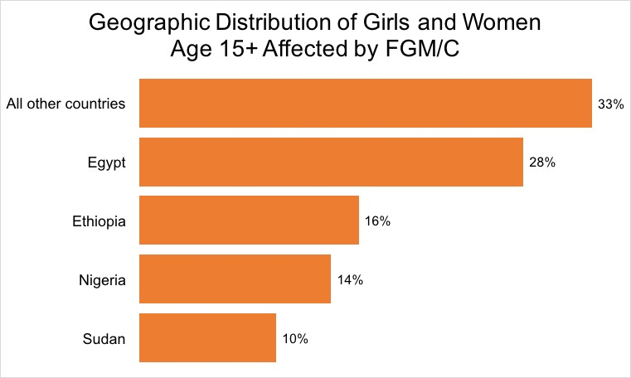
Assignment: Make it Better
© 2016 Population Reference Bureau
Notes:
For the pie chart, one suggestion to improve this is to not actually use a pie chart. The segments are a bit difficult to compare in size so here is what it looks like as a bar chart instead.
[CLICK to bring on bar chart] It’s easier to tell which one is highest, both because it’s the longest line and it’s ordered from highest percent to lowest. Note that we’re using all the same color here because we want the viewer to compare lengths of bars, not colors.
If you did want to stick with the pie chart, we suggest you start with the largest segment at the 12 o’clock point, then ordering it from highest to lowest segment going clockwise.

Slide 21
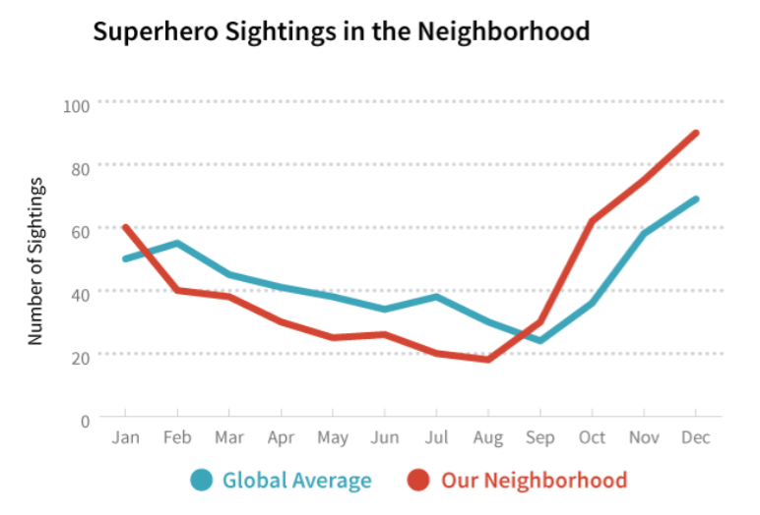
Assignment: Make it Better
Data + Design
Notes:
This is a line graph on “superhero sightings in the neighborhood.” We can see that it has become quite a jumble with that many in there.
[CLICK to bring on revised line graph]
Here’s the graph with only two lines shown, the global average and our neighborhood. The global average line gives context to our neighborhood line. And obviously, we’d want to see how many superhero sightings were right where we live! Also note that the scale on the bottom has changed. Instead of looking at four months, we’re looking at an entire year to get a bigger picture of what’s happening.

Slide 22
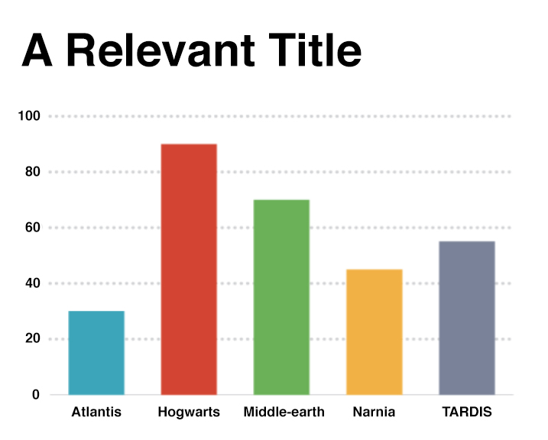
Assignment: Make it Better
Data + Design
Notes:
And finally here we have our 3D graph. We don’t recommend using three dimensions in your data visualizations unless there’s some very specific need or reason for it. It’s too difficult to see what’s actually going on when these bars are all angled differently.
[CLICK to bring on improved bar graph]
In our improved example, we’ve also added a title and moved the scale to the left side, where it is most commonly expected to be seen. We’ve left the colors here, but you can consider only using one color as in the previous slide. A good reason to leave the different colors in is if you have color coded these categories throughout your presentation or publication so people can associate a certain color with a specific category consistently.

Slide 23
HOW TO MAKE A DATA VISUALIZATION
Notes:
Now I’ll share some tools and workflow suggestions on how to put together a data viz.

Slide 24
Tools for Creating
Excel/Powerpoint
Infogram (infogr.am/beta)
Tableau (tableau.com)
Piktochart (piktochart.com)
Easely (easel.ly)
Visage (create.visage.co)
Notes:
You all know about Excel and Powerpoint, but here are some alternative programs you may consider using. They all have free versions or trial versions for you to test them out. Infogram is an easy to use site that has a variety of visualizations to choose from. It also has the capability of adding interactivity to your visuals, so you can embed them in a website and have people click on them to change the visual. Tableau is a popular one for advanced data viz producers. Piktochart is good for infographics, if that’s the design direction you want to go in. Easely can do data viz or infographics and has many templates to choose from. Visage is a site that incorporates photography into your data viz.

Slide 25
Suggested Workflow
Experiment with different visuals in a program—let the visual give you ideas on what the story is
Decide which type of visual makes the most sense
Figure out which design options work best
Build final graphic
Notes:
Our suggested workflow is to start by experimenting. The great part about a program like Infogram is that you can easily click through different visual types to see which one will work for you. You will often need to see the data graphed out before making further decisions on design. Once you’ve made a decision on which visual makes the most sense to use, then figure out which design options work best. This will be a trial and error process. Then you can put any finishing touches on the final graphic.

Slide 26


Suggested Workflow
Can also sketch ideas then use program like Piktochart to build it out
© 2015 Population Reference Bureau
Notes:
Another good way to get ideas is to brainstorm and sketch.

Slide 27
Need Help or Suggestions?
Google it! (“how to…in Excel”)
Join the Knowledge Gateway’s listhost: https://knowledge-gateway.org/dataviz
Helpmeviz.com is an online community that works to improve your visuals
Work with a professional designer
Notes:
If you run into a question about how to do something, your first option is to Google it. There are also some online communities here that are devoted to data viz. If you are really having trouble or want to build something special, hire a professional designer. You can help come up with a concept and work with them to build out the final design.

Slide 28
Online Resources
Data + Design: A Simple Introduction to Preparing and Visualizing Information– infoactive.co/data-design/
Data Visualization 101: How to Design Charts and Graphs Free E-Book– visage.co/content/data-visualization-101
PolicyViz–http://policyviz.com/
Storytelling with Data– storytellingwithdata.com/
Notes:
These are some online resources in case you would like to learn more.

Slide 29
For Inspiration
Search Pinterest
informationisbeautifulawards.com
nytimes.com
worldpopdata.org
healthdata.org
africanhealthstats.org
ourworldindata.org
columnfivemedia.com
Notes:
If you need a creativity boost, check these options out.

Slide 30
Books
The Truthful Art: Data, Charts, and Maps for Communication
Visualizing Data: Exploring and Explaining Data With the Processing Environment
How Maps Work: Representation, Visualization, and Design
Better Presentations: A Guide for Scholars, Researchers, and Wonks
Infographics: The Power of Visual Storytelling
The Wall Street Journal Guide to Information Graphics: The Dos and Don'ts of Presenting Data, Facts, and Figures
Visualize This: The FlowingData Guide to Design, Visualization, and Statistics
Knowledge is Beautiful
Notes:
For those of you who are really into this field, these are some books about data viz.

