Slide 1
Visualizing Data
Part One: What, Why, and How to Start
Notes:
Welcome to our presentation on Visualizing Data.

Slide 2
Goals of the Presentation
You will learn:
What makes a data visualization
Why they can be effective
How to plan
Notes:
Our goals for Part One of the presentation are to teach the basics of data visualization or “data viz” as we will call it. You will learn the definition of data viz, why they can be effective to communicate information, and how to plan for one. Part Two of this presentation will review useful design tips for data viz and some suggested tools you can use to make them. After listening to the two parts, we hope that you can create compelling data visualizations on your own or direct a designer to help you achieve your data viz goals.

Slide 3
WHAT IS
DATA VISUALIZATION?
Notes:
So our first question to answer is what is data visualization? Let’s see what people here think.

Slide 4
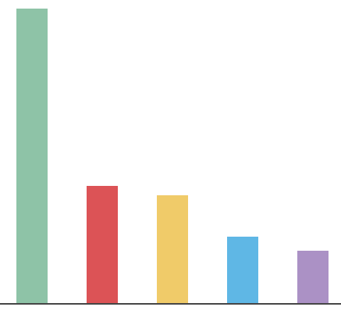

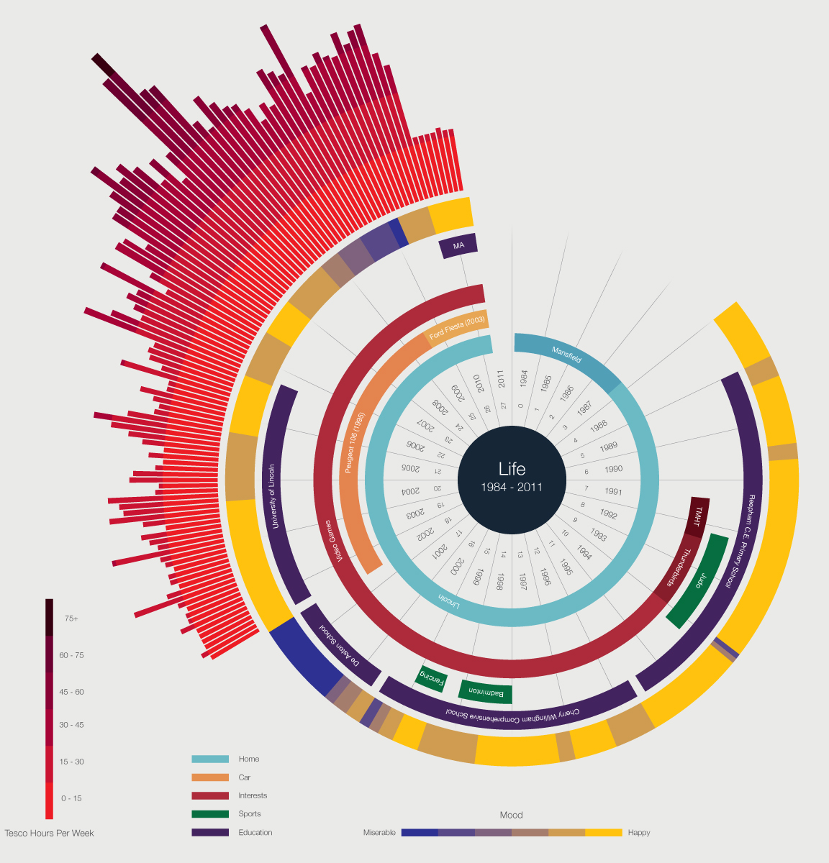

Name the Data Visualization
58%
George Patterson, The Noun Project
Map data © 2016 Google
© Ben Willers
Notes:
These are four examples of graphics that may or may not be considered a data viz. I will preface this by saying the answer to what is a data viz will not always be clear. For the first one, this bar graph, please raise your hand if you think this is a data viz. Now raise your hand if you don’t think so. Is anyone unsure? Does anyone want to explain why they thought yes or no? Generate responses. Do the same for next three examples, but proceed quickly. Note that we will offer our opinion on what is/is not data viz on slide 7.

Slide 5
“Nicely designed posters with a few numbers on them aren’t really data viz.”
– Amanda Cox
Editor of Upshot, New York Times
Notes:
This is a quote from Amanda Cox, who does a lot of data viz work at The New York Times (which is a good place to look for examples, by the way). “Nicely designed posters with a few numbers on them aren’t really data viz.” This quote nails one thing that you MUST have to be a data viz, and that is NUMBERS. But as Amanda points out, you need more than numbers.

Slide 6

Defining the Medium
Data visualization: A nontext- based representation of data that enhances the understanding of that data.
Martha Ormiston, The Noun Project
Notes:
There are a lot of definitions for data viz floating around out there, but we’d like to propose the following one. We define data viz as a nontext-based representation of data that enhances the understanding of that data. By “nontext” we mean something other than a set of words or numbers/numerals. You’re taking numbers and turning them into something visual so that you are able to learn something more clearly about those numbers.

Slide 7
Name the Data Visualization (Revisited)
58%
George Patterson, The Noun Project
Map data © 2016 Google
© Ben Willers
Notes:
Based on our definition, let’s discuss these examples once more. The first one is your standard bar chart, which is one of the most basic type of data visualizations out there. When you take numbers and graph them with bars or lines, you’re seeing something other than text that explains what’s happening with those numbers, so that would be considered a data viz. But some of you may be looking closely and thinking, but this chart doesn’t have any numbers! Correct. We would need to add more information here for this chart to actually be a data viz… namely, the data. And labels. But we’ll get more into that later.
The second example may be a bit tricky. The thumbs up icon is a type of visual, but it’s not actually saying much about the number except that this 58% is a good thing. We would argue this icon doesn’t really turn the value of the number into anything visual, meaning you aren’t seeing 58% in a form that’s not text. Based on our definition, we’d say this example is not a data viz.
The map on the bottom left is pretty standard. It has roads, buildings, and names of places labeled, but no numbers. If we think about it, a map intrinsically contains data about distances between places so that your mind can perceive those distance numbers accurately. So we would argue that maps are data visualizations.
This last example may be what one typically thinks of when they hear “data viz.” It’s a really complicated-looking graph with a bunch of colors and geometric shapes. Yes, this could definitely be considered a data viz. But we’d also want to look more closely at it to make sure it does an effective job of communicating what these numbers mean.

Slide 8
Data Visualization vs. Infographic
These terms are sometimes used interchangeably.
Just remember: You need DATA plus a visual representing the data to make a data viz!
Notes:
“Infographic” is a term often used interchangeably with “data viz.” You’re going to find a lot of opinions out there on what constitutes a data viz versus an infographic. Just remember, for anything called a data viz, you need DATA. And not just data. You need the graphic or illustration or visual to make the data easier to understand, not just arrange the data nicely on a screen. Many infographics do not, in fact, include data.

Slide 9
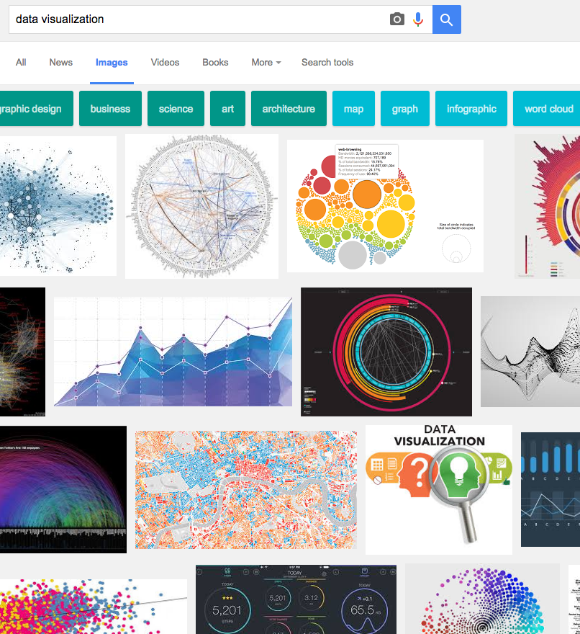
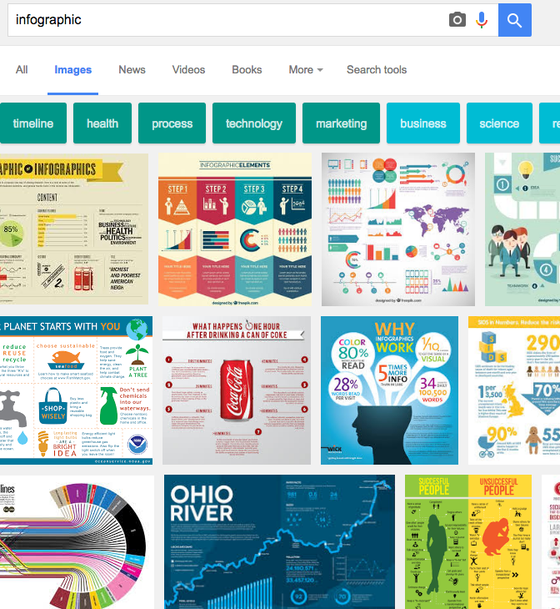
What Google Thinks
Graphs, geometric shapes, color coded, number driven
Collection of facts, icons, pictorials, text driven
Notes:
If you ask Google what a data viz is and what an infographic is, these results are what will come up. For the most part, we can see on the left that the term ”data viz” is more associated with graphs, geometric shapes, color-coded elements, and numbers. On the right, we see that “infographic” means something a little different. These examples are more like collections of facts arranged nicely with icons, pictorials, and numbers sprinkled throughout. They tend to use a lot more text in order to tell a story about a topic. Certainly, some of these infographics could include data viz examples within them, but on the whole, they look different and are more editorially driven.

Slide 10
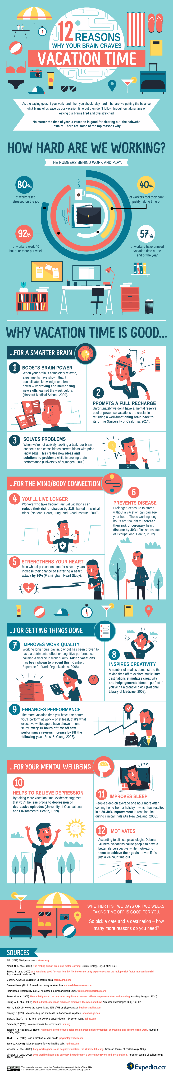
Example of infographic
© Expedia.ca
Notes:
Here is an example of what would classically be called an infographic. It includes different sections that explore subcategories of the topic. (Click) One of the sections even has a little data viz in it—a modified pie chart. (Click) But then we see another section that doesn’t have any data visualized. It’s just text that lists out facts. The style of the design is typical for infographics (nowadays). It offers a lot of little icons and pictures to draw your eye, not because they have anything to do with data, but because they are visually appealing.
Also note that this whole thing is meant to be read in order, starting with “Why Vacation Time is Good…” and then “…For a Smarter Brain”, followed by “...For the Mind/Body Connection.”

Slide 11
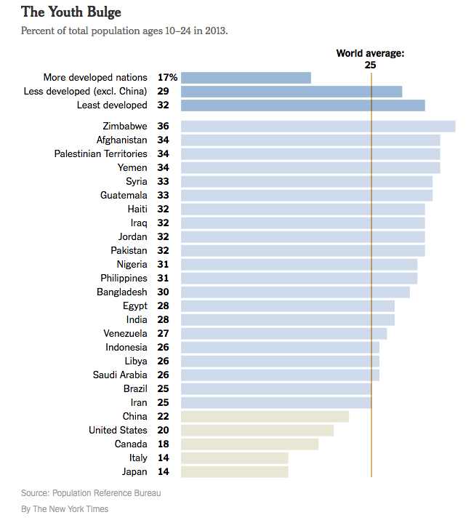
Data visualization example
Notes:
Here’s a data viz. Its main purpose is to show how these numbers relate to each other in size. There is much less text here. Your eye is simply drawn to the lengths of the bars. In this example, we can see the percent of a country’s population between the ages of 10 and 24. The vertical line shows the world average is 25 percent, so you can tell which countries are above or below the average. The variation in the color of the bars helps you quickly see that the top section is regions and the bottom section is countries below the world average.

Slide 12
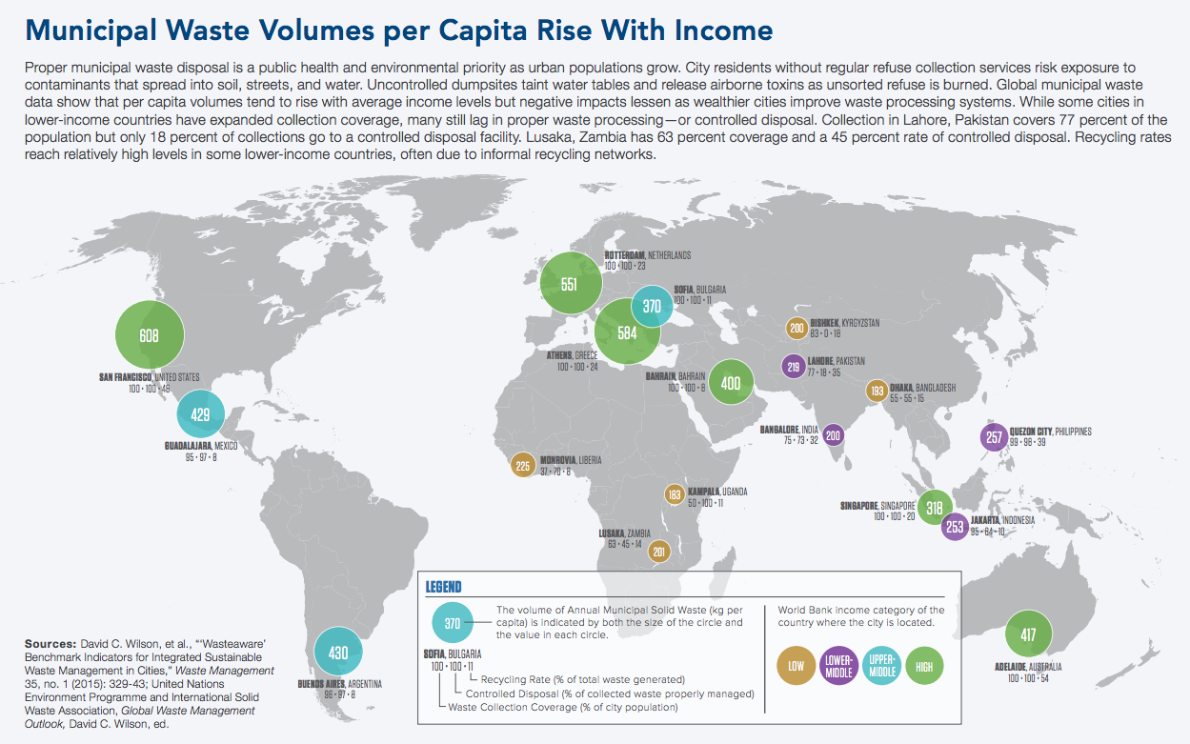
Data visualization example 2
© 2016 Population Reference Bureau
Notes:
Here’s another data viz. This example shows how municipal waste increases when cities have higher incomes. The bubbles are sized proportionally according to the volume of waste and color coded to show relative income level. Now here, we do have more text, so we’re not excluding text as a possible component of a data viz. But the main focus here is the map, which makes the data visual through the location of the numbers on the map, the size of the shape they are on, and the color.

Slide 13
“[I emphasize] visualizations that do some work; they persuade, they explain, they explore. Beauty is desirable, but I’m not excited by pretty charts that are also pretty useless.”
– Graham Wills, Data Science and Visualization Expert at IBM
Notes:
Here’s another quote, this time by Graham Wills at IBM that I hope helps with our definition. “I emphasize visualizations that do some work; they persuade, they explain, they explore. Beauty is desirable, but I’m not excited by pretty charts that are also pretty useless.” So again, the idea is that data viz is doing more for us than looking pretty.

Slide 14
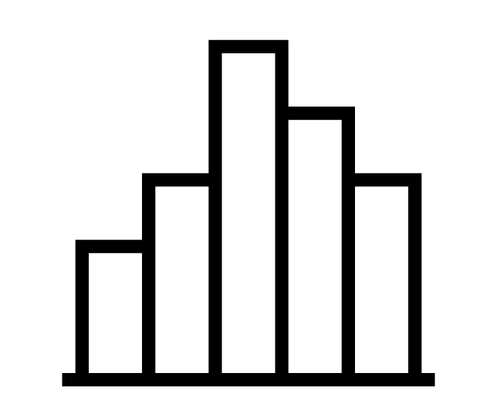
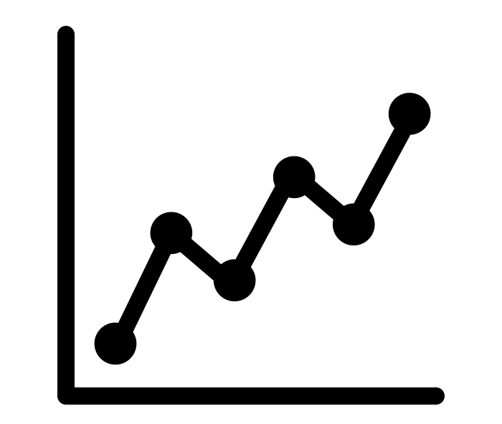
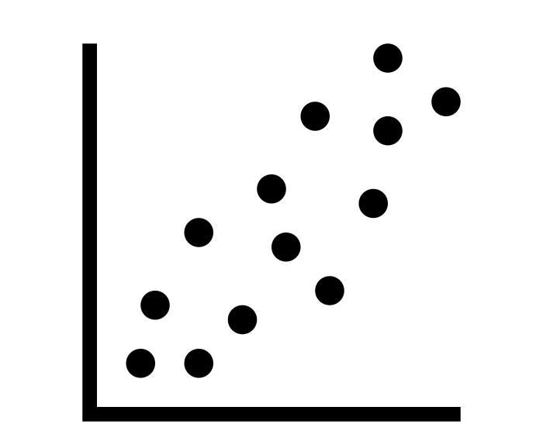
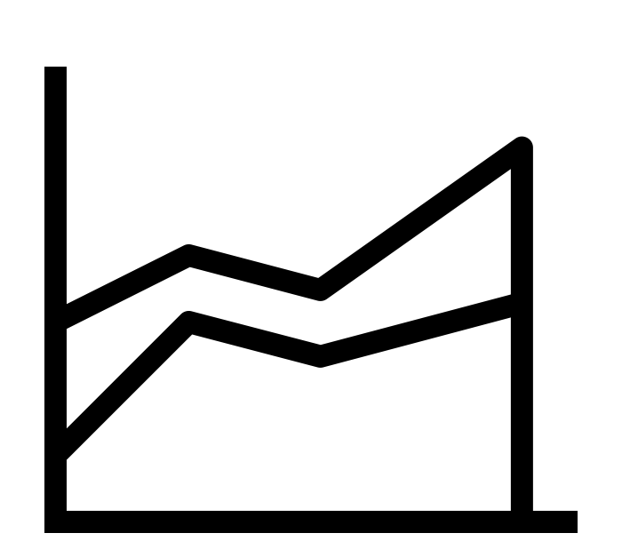


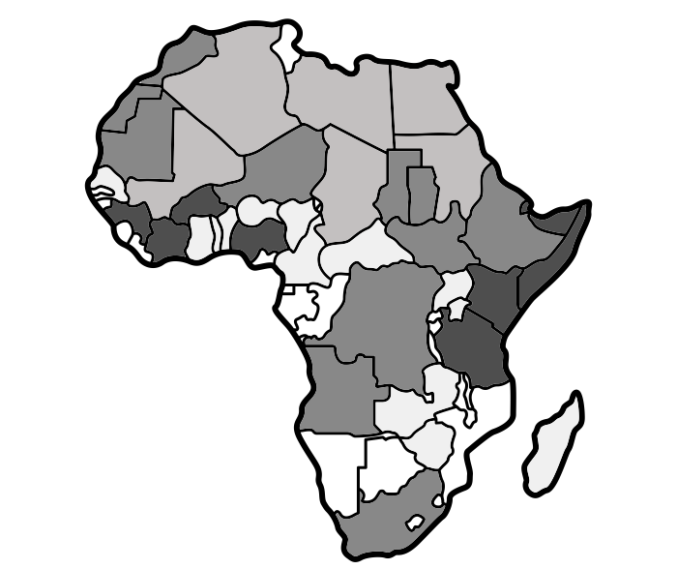
Basic Data Visualizations
Bar chart
Line chart
Scatter plot
Area chart
Pie chart
Bubble chart
Heat map
Alexander Blagochevsky, Austin Condiff, Pham Thi Dieu Linh, Yohann Berger, Sergey Demushkin, The Noun Project
Notes:
Here is a list of some of our basic data visualizations. And yes, they are what we’ve traditionally called graphs or charts. Some of you probably already have a lot of experience in data viz because you’ve created lots of graphs! Each one is good for showing a particular type of data set. For example, a line chart displays change over time. An area chart does the same, but can also show volume.

Slide 15
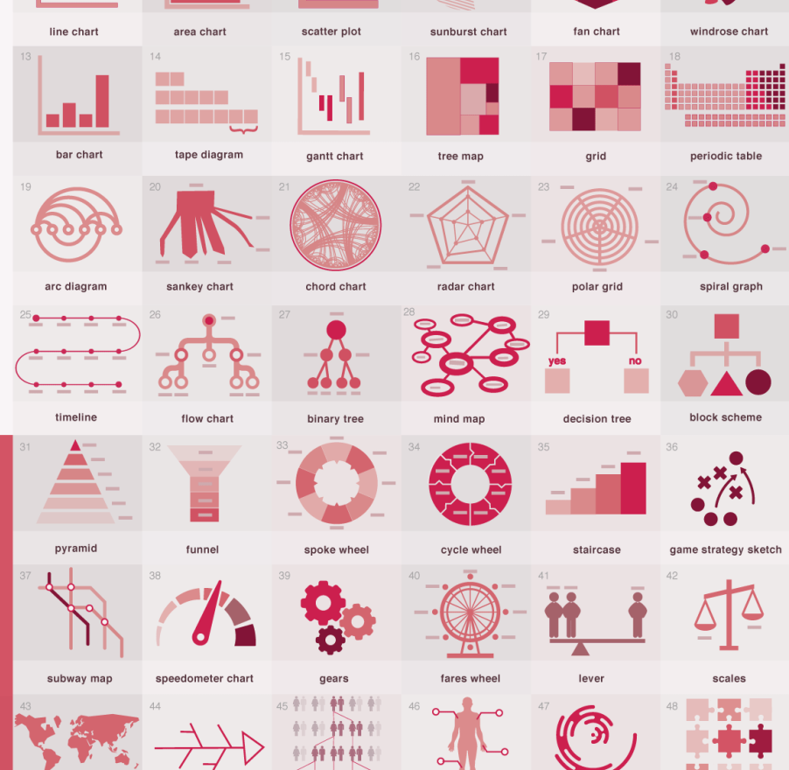
Other types
© Anna Vital
Notes:
But with data viz, we can expand our universe of what we can do with numbers to make them more understandable. The possibilities of how to present data in a visual way are really endless. But although the possibilities are endless, not every possibility is a good one. And more complex visualizations are not inherently better.

Slide 16
WHY USE DATA VISUALIZATIONS?
Notes:
So why do we bother spending time building these types of graphics? It takes extra time to carefully plan and build one versus writing information out or providing raw numbers. But the benefits to your audience can make it worth it.

Slide 17

Speed
Attention span has FALLEN from 12 seconds in 2000 to 8 seconds in 2015
Data visualizations allow quicker understanding of a data set
Attention Spans study, Microsoft Corp. 2015
Notes:
Our first reason for using data visualizations is speed. Did you know that adult attention spans have been falling dramatically over the past 15 years? We can blame the internet, but I only have 8 seconds on this slide to reach my point with you or else I’ve lost your attention.
With data viz, we can aim to convey meaning within a few seconds and not make people do the work of deciphering what’s happening.

Slide 18
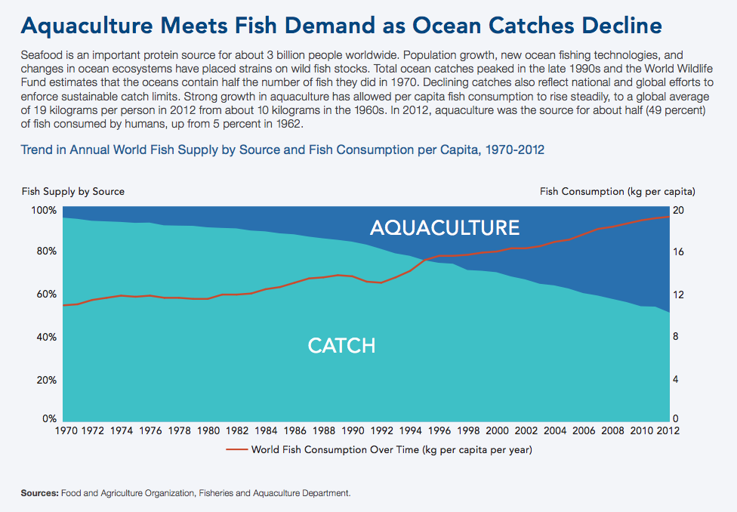
Comprehension
© 2016 Population Reference Bureau
Notes:
The second reason to use data viz is comprehension. The headline here reads, “Aquaculture meets fish demand as ocean catches decline.” The graph shows how fish supply compares to fish consumption over time. You probably didn’t need to read this paragraph to see that something is changing here. The red line represents world fish consumption and the light blue area is the amount caught. The red line is going up while the light blue portion is going down. The years here span from 1970 to 2012 so you can see exactly how fast this disparity is developing. This graph makes it easy to understand that people are eating more fish, but the amount being caught is going down. A lot of information is contained in the visual, it’s easy to understand, and it has a clear and concise title to help you understand the key message quickly.

Slide 19

Appeal
We could list percentages for stats.
Or...
© Millward Brown, Y&R São Paulo
Notes:
The third reason we like data viz is for the appeal. In this unusual example, we have a photograph playing a central role. The woman’s earring is a pie chart with the red segment showing the percent of Zimbabwe’s men who believe having sex with a virgin girl can cure HIV. The blue portion represents those who don’t believe this. The legend has also added a third category not shown in the pie chart―men who have actually been cured of HIV through this method―to make the point that it’s not a real solution. They’ve taken what could simply be a summary of percentages or a basic pie chart and turned it into something memorable. This example shows how data viz can draw attention in ways that text alone cannot.

Slide 20
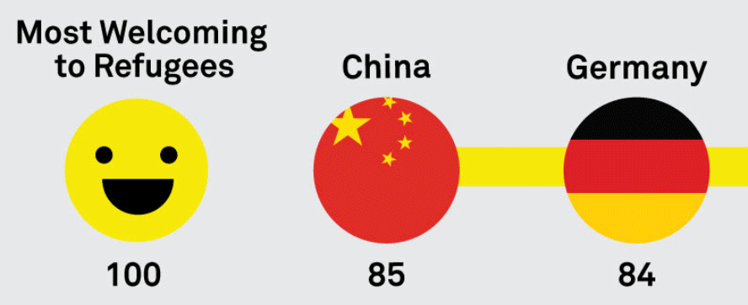
Retention
Which example have we not seen before?
58%
George Patterson, The Noun Project
© Good
© Ben Willers
Notes:
The fourth reason to use data viz is retention. Do you remember these examples from before? Which of these examples have we not seen yet in this presentation? Generate responses.
It’s the one on the bottom left. This shows how visuals are great at cementing information in our brains.

Slide 21
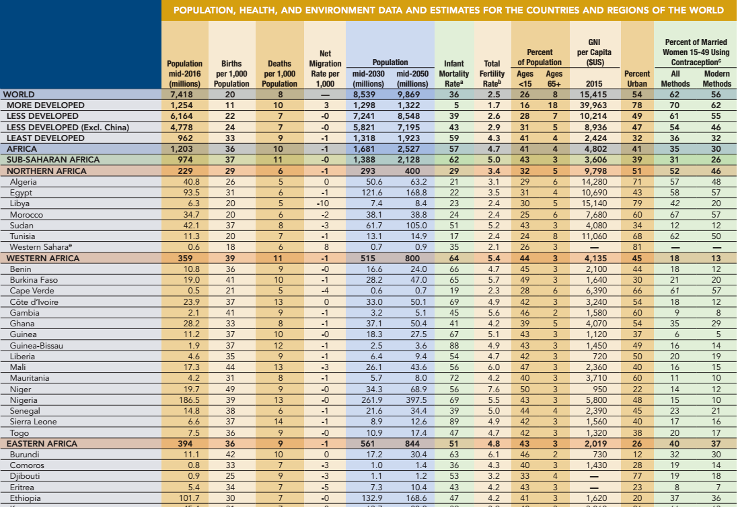
World Population Data Before Visualization
© 2016 Population Reference Bureau
Notes:
This table of world population data is drawn from PRB’s World Population Data Sheet. It’s good for looking up numbers on a specific country or indicator, but how can you tell what’s happening when it comes to world population?

Slide 22
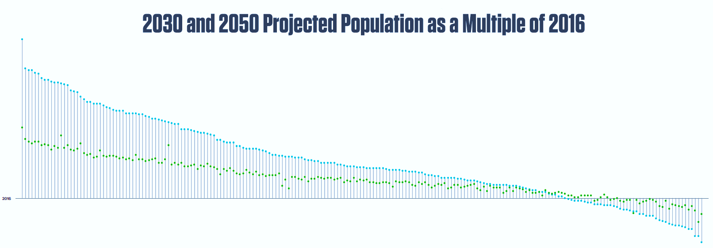
World Population Data After Visualization
© 2016 Population Reference Bureau
Notes:
Here’s one way we’ve visualized some of the data from the previous table. We’ve depicted the world population numbers for 2016, 2030, and 2050 by country, then ranked each country starting with the one with the fastest rate of growth to the one with the slowest rate. You can see that for most countries in the world, population is growing because they are above the horizontal baseline of zero growth.
This graphic demonstrates all the reasons we listed before about why we use data viz: speed and comprehension of information, appeal, and (hopefully) retention. Look at this graphic for a few seconds. If you close your eyes now, could you estimate about what percent of the world’s countries have growing populations? Now open your eyes and see if you were right.

Slide 23
PLANNING YOUR DATA VISUALIZATION
Notes:
Next, we’re going to talk about the things to think about when developing a data viz.

Slide 24
A Good Data Visualization
Must be accurate and not misrepresent data
Must be easy to understand
Relates to your audience
Only shows what’s necessary
Notes:
When planning out how to present the data visually, you must follow these rules.
First and foremost, we need to be accurate. Accuracy includes not misrepresenting data. People should have an understanding of the truth so make sure your visualization is being truthful.
The second must-have is that a visualization must be easy to understand. If it requires several minutes to comprehend or if it’s confusing, then it’s not doing its job.
The third rule is that the visualization should relate to your audience. Consider your audience’s point of view. Whenever you create a visualization, it should answer the question, “So what?” so that your audience cares about the information being presented.
The fourth rule is that the visualization only shows what is necessary. You want everything streamlined and on point. If you need to add annotations or something else visual to make it clearer, then do it. You should achieve a balance between minimizing visual clutter and giving enough information.

Slide 25
Common Mistakes With Data Accuracy
Mixing up percent change and percentage point change
Pie chart does not add up to 100 percent
Proportionally sized bubbles using diameter instead of area for sizing
Oversimplifying data so you don’t get enough context
Truncating y-axis
Notes:
When it comes to showing data accurately, here are some common mistakes. Mixing up percent change and percentage point change is a big one. Having a pie chart that does not add up to 100 percent is another.
Trying to use proportionally sized bubbles or circles based on the length of the diameter rather than the area of the circle. If you use the diameter instead of the area, you exaggerate the proportions and everything seems like a bigger difference than it really is. If you use the area, it’s a more accurate representation of the size of a data point compared to other data points.
Oversimplifying data to the point where you don’t get enough context. And truncating the y-axis, meaning you start at a number other than zero in order to exaggerate the difference between similar numbers.

Slide 26
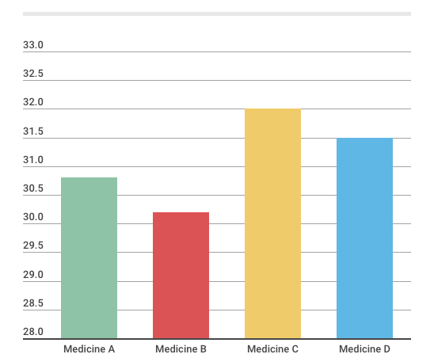
Truncated Axis (before)
Percentage of Patients Doing Better on Medicines A, B, C, and D
Notes:
Here’s an example of truncating the axis. This graph shows the percentage of patients doing better on Medicines A through D. The y-axis is the percentage of people doing better on that particular medicine. It looks like the share of patients doing better on Medicine C is much greater than the others. But look closely at the numbers. We have a truncated axis here. Instead of starting at zero, it starts at 28 percent and goes up to 33 percent, which makes the difference between the four medicines look bigger than it actually is.

Slide 27
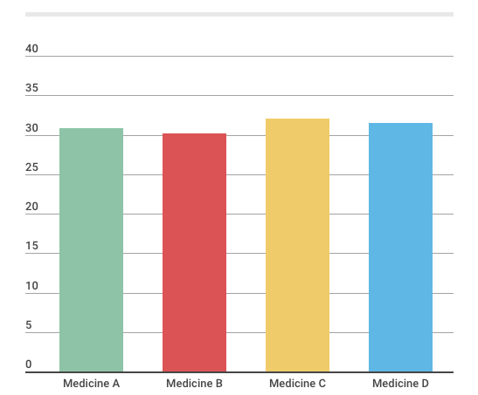
Truncated Axis (after)
Percentage of Patients Doing Better on Medicines A, B, C, and D
Notes:
Here’s the same data, but with the y-axis starting at zero and going up to 40 percent. Now the bars look very close to each other, almost exactly the same. So the previous chart made Medicine C look a lot more effective. But this chart better reflects the truth, as it captures the relatively small difference between the four medicines.
There may be instances where truncating the axis is acceptable―for example, if your research reveals that the differences between A, B, C, and D are truly statistically significant. But before you truncate an axis to magnify the difference between bars, think about the reason you are making the change.

Slide 28
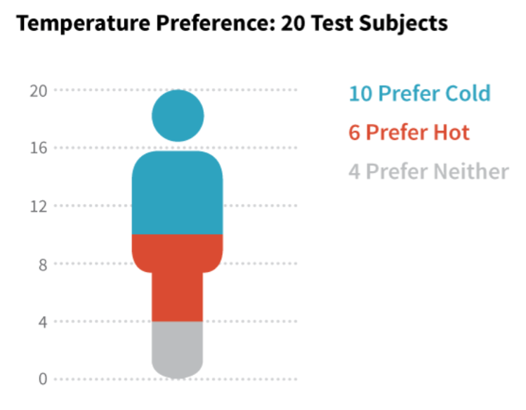
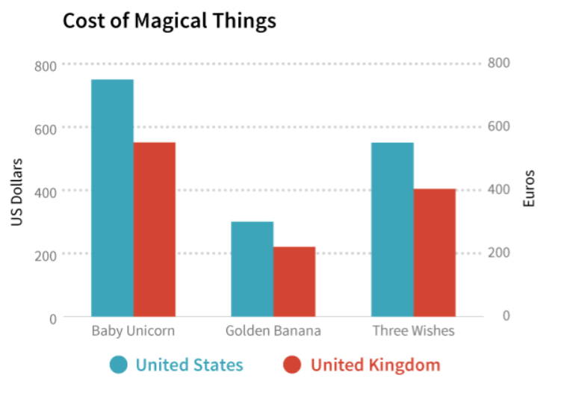
Activity: What’s Wrong Here?
Data + Design
Notes:
Let’s discuss what’s wrong with these two examples.
First, the graph on the left shows the temperature preference of 20 test subjects. Ten prefer cold, six prefer hot, four prefer neither. We have a shape of a person divided up to represent the three categories of responses. What doesn’t work for this graph? What does work? Generate responses.
We have a shape of a person divided up to represent the three categories of responses. However, this shape is not one that can be geometrically divided into three parts easily. So it’s difficult to tell which response was the most common without reading the text on the side.
Next, on the right, we have a bar chart showing “the cost of magical things” in the United States and United Kingdom, shown in blue and red. The axis on the left is in dollars and the right is in euros. What’s wrong here? Generate responses.
They have put 400 dollars on the same line as 400 euros, which is not correct, making it seem like a baby unicorn or golden banana is more expensive in the United States. What we need to do is pick one currency (preferably, the one that our audience is going to be using), then convert all the data to that one currency, THEN compare the bars for the costs in both countries. If we did this, we’d see that the cost for unicorns, bananas, and three wishes are actually the same.

Slide 29
Identifying the Story in Data
Kenya
DHS Survey Year | % of Demand for Family Planning Satisfied with Modern Methods
2014 | 70.7
2008-2009 | 55.5
2003 | 47.3
1998 | 47.0
1993 | 40.1
Source: Demographic and Health Surveys, Various Years
Notes:
So where do you start once you have your data ready? You are going to have to determine what the story is that you want to tell. Here are the percentages of demand for family planning satisfied with modern methods for Kenya between 1993 and 2014.
We can use data viz to both discover and tell the story in these numbers.

Slide 30
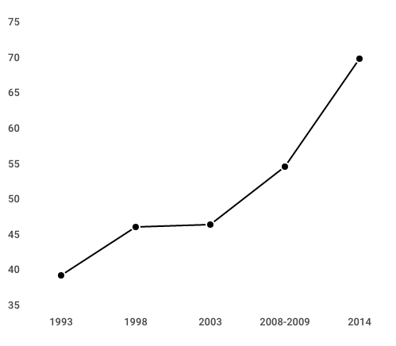
What’s the Story?
Notes:
Since we’re dealing with time progression, we can use a line graph to see what’s happening with the table I just showed you.

Slide 31
What’s the Story?
Biggest gain was recent
Something changed,
surpassed 50%
Rate stagnated
Notes:
One story we might want to focus on is the fast gain that happened between 2008 and 2014. But maybe your aim is to talk more about programs that have helped the rate increase? (Click forward) Then we’d want to look at this segment, since this is when the rate went above 50%. (Click forward) Or maybe your aim is to talk about something that didn’t work. You could highlight this line here to illustrate that point and maybe give some more context on why this happened.

Slide 32
Identifying the Story in Data
Country | Survey Year | mCPR | % of Demand for Family Planning (FP) Satisfied with Modern Methods
Benin | 2011-2012 | 7.9 | 17.4
Burkina Faso | 2010 | 15.0 | 36.9
DRC | 2013-2014 | 7.8 | 16.3
Cote d’Ivoire | 2011-2012 | 12.5 | 27.5
Ghana | 2014 | 22.2 | 39.2
Kenya | 2014 | 53.2 | 70.7
Rwanda | 2014-2015 | 47.5 | 65.8
Tanzania | 2010 | 27.4 | 48.3
Zambia | 2013-2014 | 44.8 | 63.8
Zimbabwe | 2010-2011 | 57.3 | 78.3
Source: Demographic and Health Surveys, Various Years
Notes:
Here’s another data set, but this time it shows different country rates of contraceptive prevalence and the percent of demand for family planning satisfied.

Slide 33
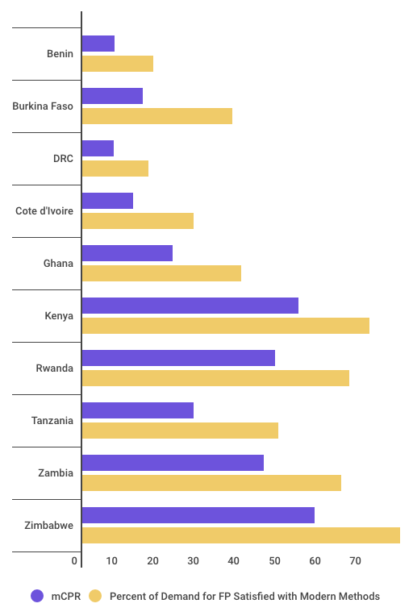
What’s the Story?
Lower mCPR countries have lower % demand satisfied?
Notes:
Since we’re dealing with two data points per country, we chose to do a bar chart with the two data points side-by-side for each country. When we graph it out at first, it’s hard to tell whether there’s something going on between the two stats. It seems like lower mCPR countries may have lower percent demand satisfied, but it’s difficult to tell.

Slide 34
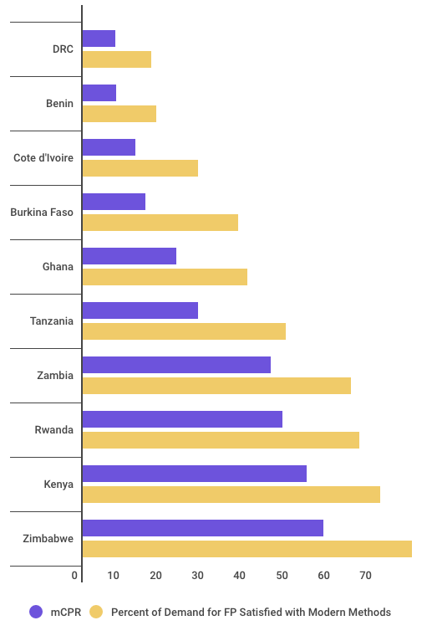
What’s the Story?
Reordered countries show lower mCPR countries have lower % demand satisfied
Notes:
But when we reorder the countries by mCPR, we can see that the lower mCPR countries do indeed have lower percent demand satisfied. By experimenting with the visualization, we can better interpret the data for ourselves and figure out how we want to show it in the end product for our audience.
This brings us to our next topic…

Slide 35
Who is Your Audience?
Where are they from?
Do they work in the field? In a position of power?
What is their demographic?
How are they viewing the information?
Are they educated?
Are they skeptics?
Why should they care?
Notes:
…our audience. Think about the people who you want to see your data viz. Here are some questions you should be asking yourself before making any further decisions on what the story is or how to design something. Where are your audience members from? Do they work in the field? In a position of power? What is their demographic? How are they viewing the information? Are they educated? Skeptical? And why should they care about the subject matter? All of this information connects to what you learned in the strategic communication module. Understanding your audience and considering your communication objective carefully will help you produce a better data visualization.
Let’s say you are dealing with an uninformed audience. You would then know you’re going to have to make things simpler for them to understand or provide more explanation on terms or concepts they might not know about. What if they don’t have access to the internet? Then you know that you’re going to have to print something, and that might mean sizing your graphic to fit a sheet of paper. The question “Why should they care?” is the most important one here. If your graphic doesn’t compel or inform your specific audience, then you have missed the point.

Slide 36
Tailoring Content to Your Audience
Notes:
This was our previous chart on mCPR and percent demand satisfied. Let’s say our audience included knowledgeable policymakers from Burkina Faso.

Slide 37
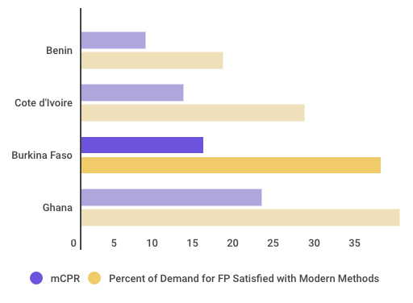
Tailoring Content to Your Audience
Knowledgeable, from Burkina Faso
Benin
Cote d’Ivoire
15%
Burkina Faso
37%
Ghana
0
5 10 15 20 25 30 35
mCPR
Percent of Demand for FP Satisfied with Modern Methods
Notes:
We’ve taken that previous chart and now pared it down to only the countries in West Africa. We knew that our audience in this case would probably only want to see how their country fared compared to others in their region. We’ve also designed the graph so their country really stands out, making it easy to see where they stand in comparison. Why include other countries if that’s not what the audience wants to see?

Slide 38
Summary: Data Visualization
Nontext-based display of data that enhances the understanding of that data
  Speed
  Comprehension
  Appeal
  Retention
Identify the story
Consider audience
Don’t misrepresent the data
Notes:
In summary, data visualizations are nontext-based displays of data that enhance the understanding of that data. They can be as simple as a bar chart―and that means that all of you probably have some experience doing data viz already. But they can also be complex.
The key principles of good data visualization include that the visualization improves understanding of the data―helps the audience understand the data faster or understand a story in the data. So be wary of complexity. A data visualization doesn’t need to be complex or use a fancy tool to be effective in helping the audience understand. Data visualizations should be appealing and can help the audience retain and remember the data.
We covered several elements of what makes a good data visualization. In your planning, you need to find the story in the data, consider who your audience is and what they need to know, and above all―ensure that your data viz does not in any way misrepresent the data.

